Slide 1
HTML TAGS

Slide 2
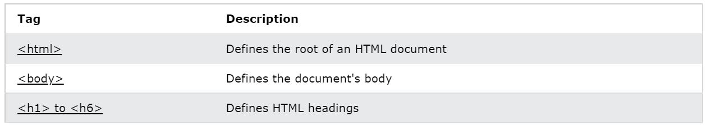
HTML Headings

Slide 3
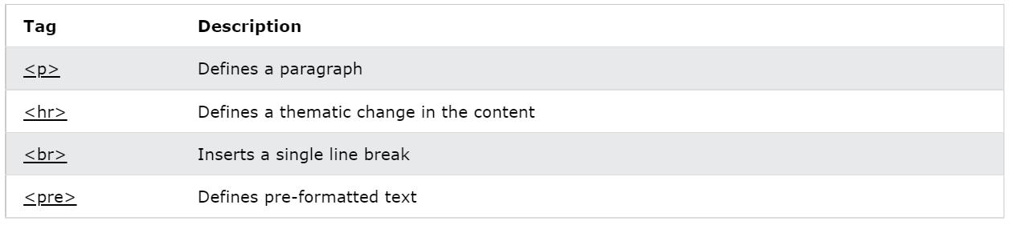
HTML Paragraphs

Slide 4
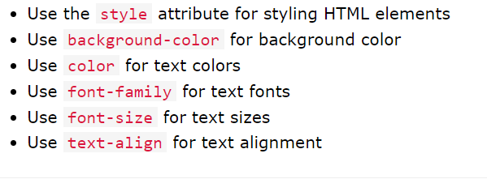
HTML Styles

Slide 5
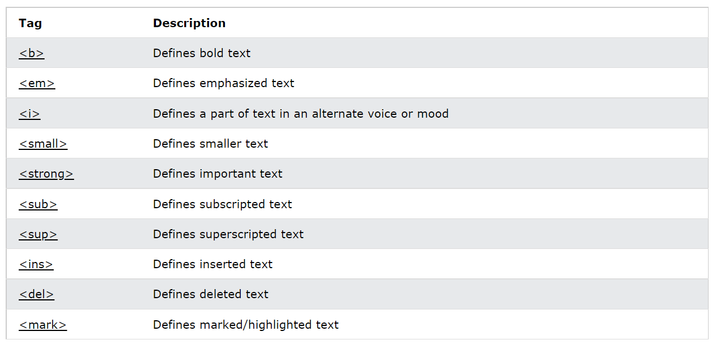
HTML Formatting

Slide 6
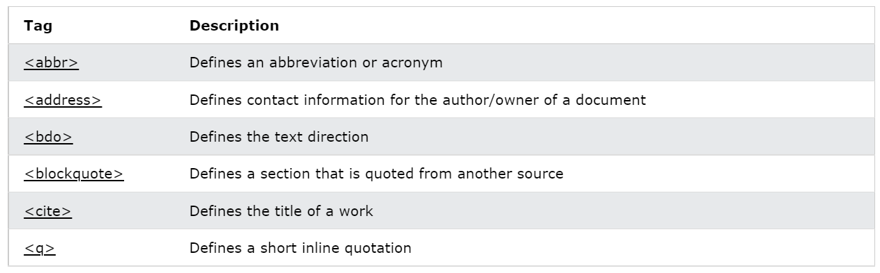
HTML Quotations and Citations

Slide 7
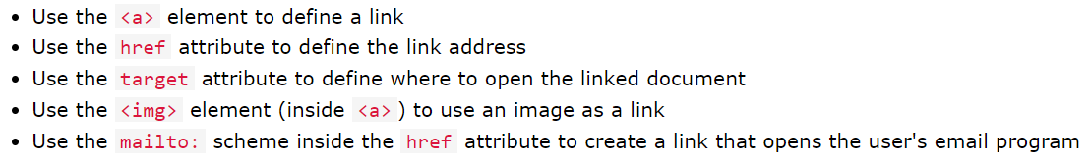
HTML Links

Slide 8
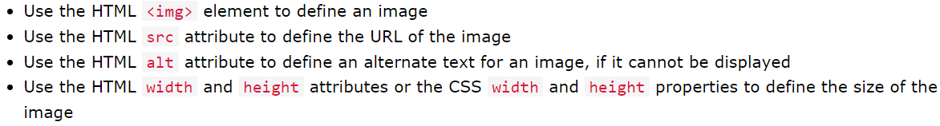
HTML Images

Slide 9
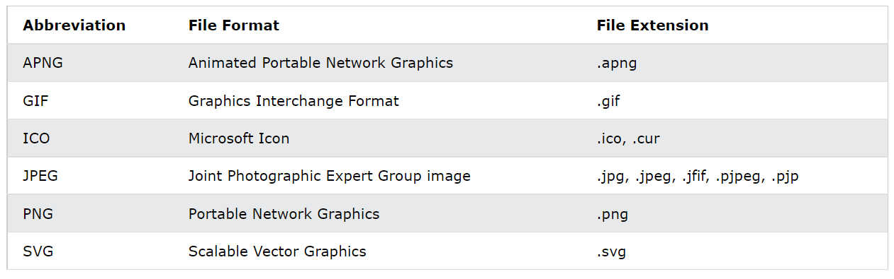
Common Image Formats

Slide 10
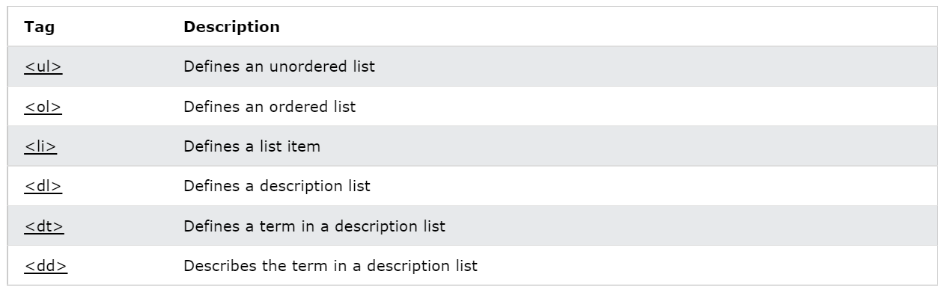
HTML Lists

Slide 11
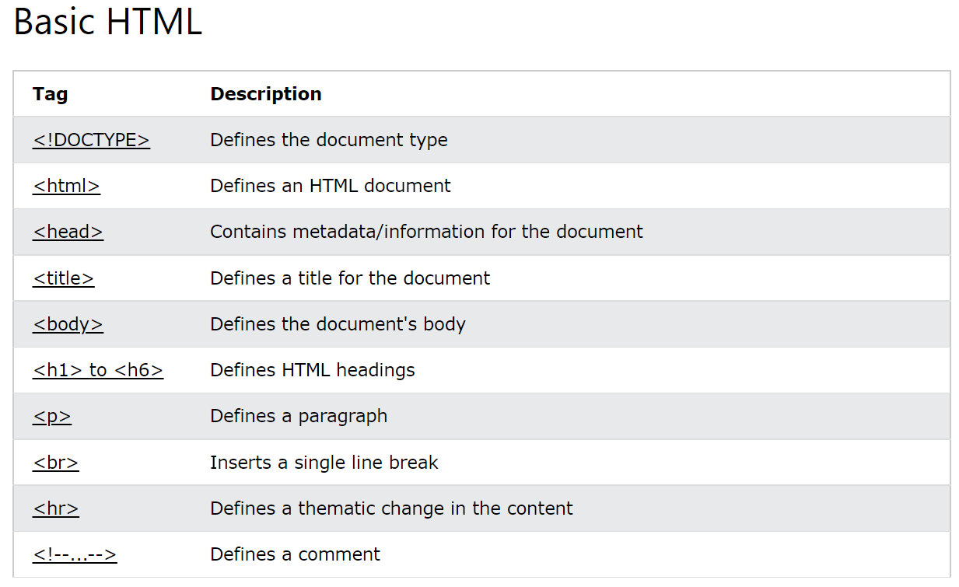

Slide 12
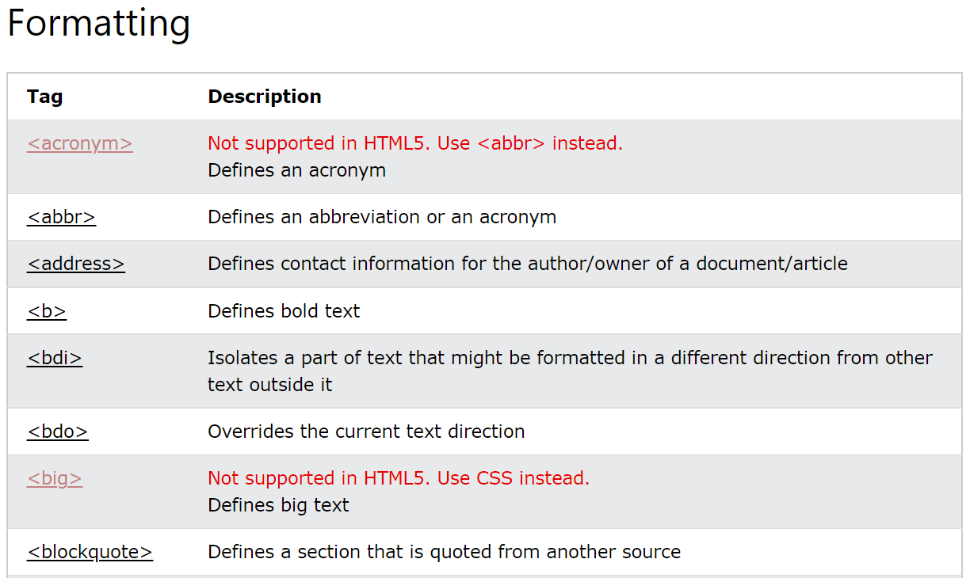

Slide 13
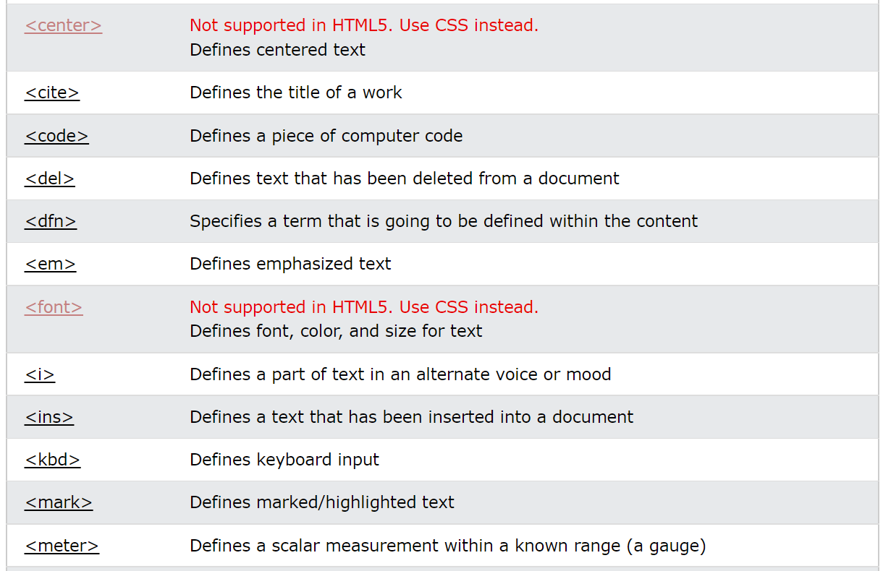

Slide 14
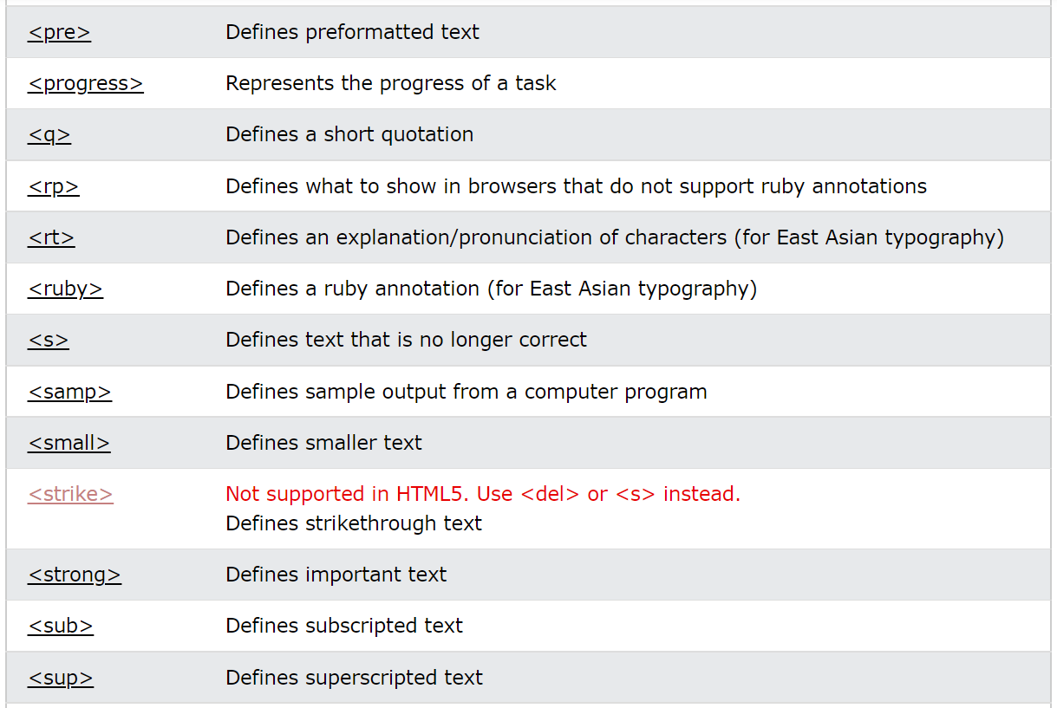

Slide 15
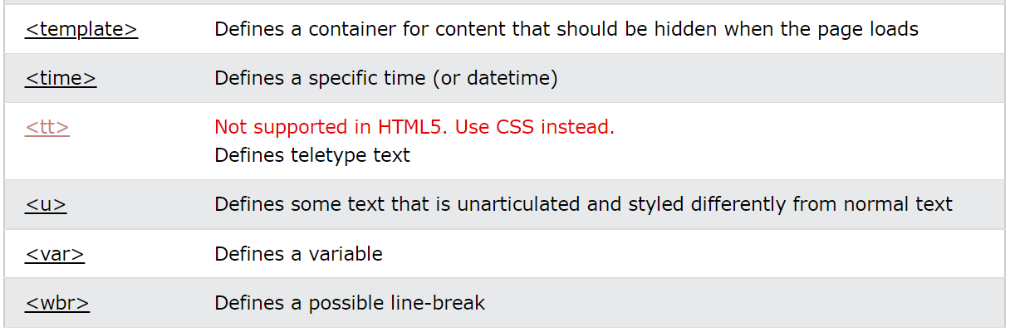

Slide 16
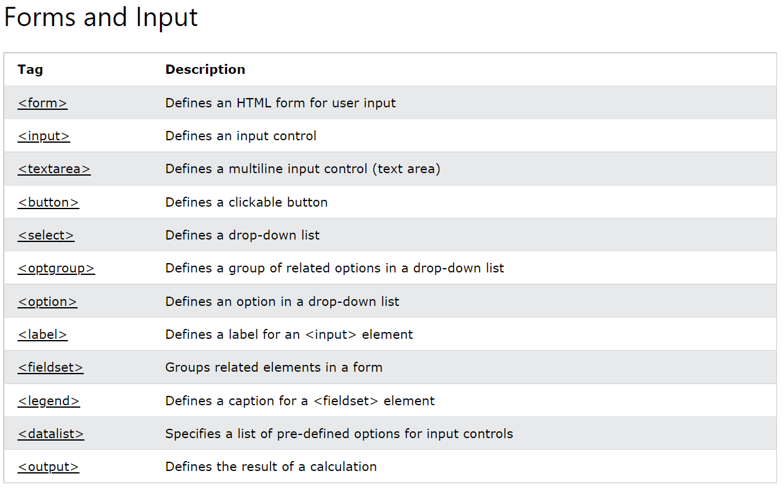

Slide 17
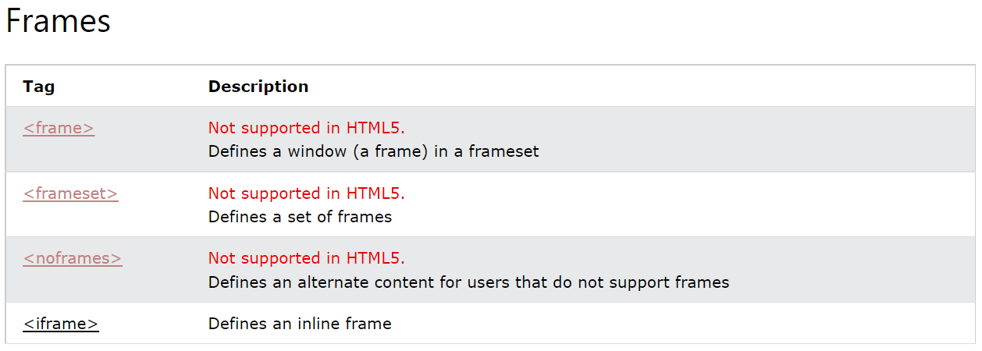

Slide 18
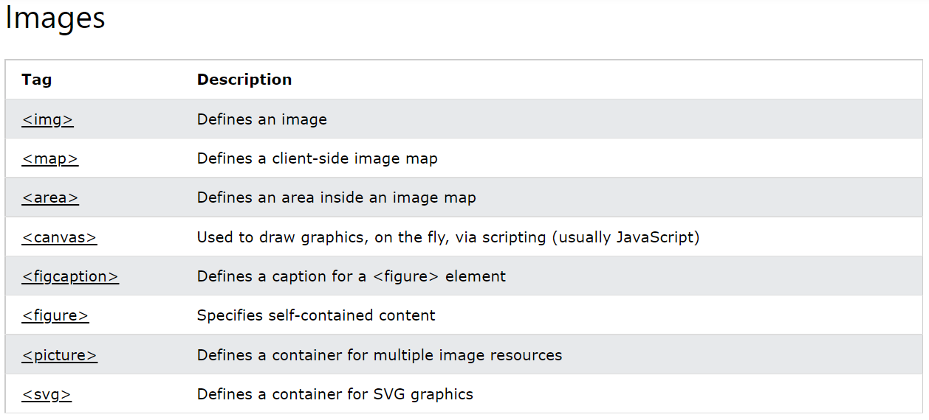

Slide 19
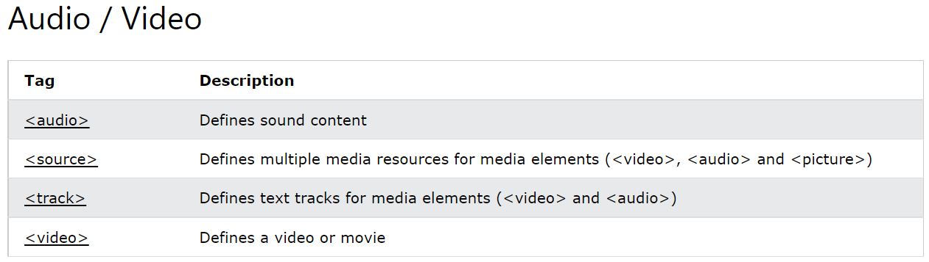

Slide 20
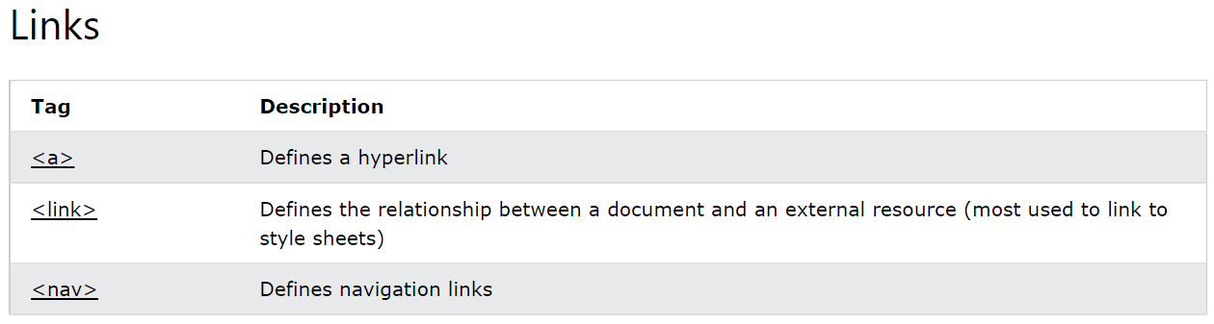

Slide 21
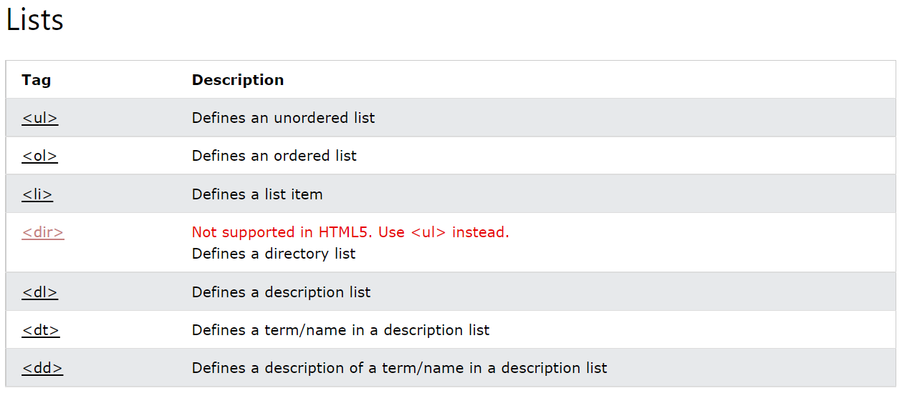

Slide 22
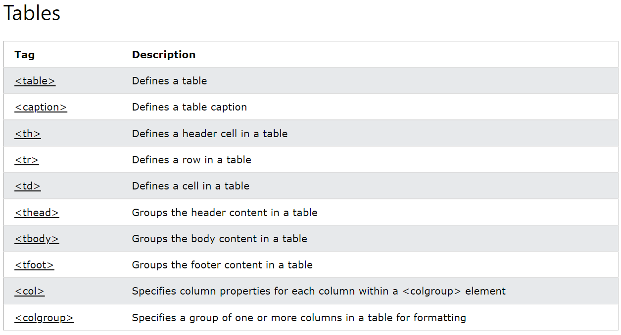

Slide 23
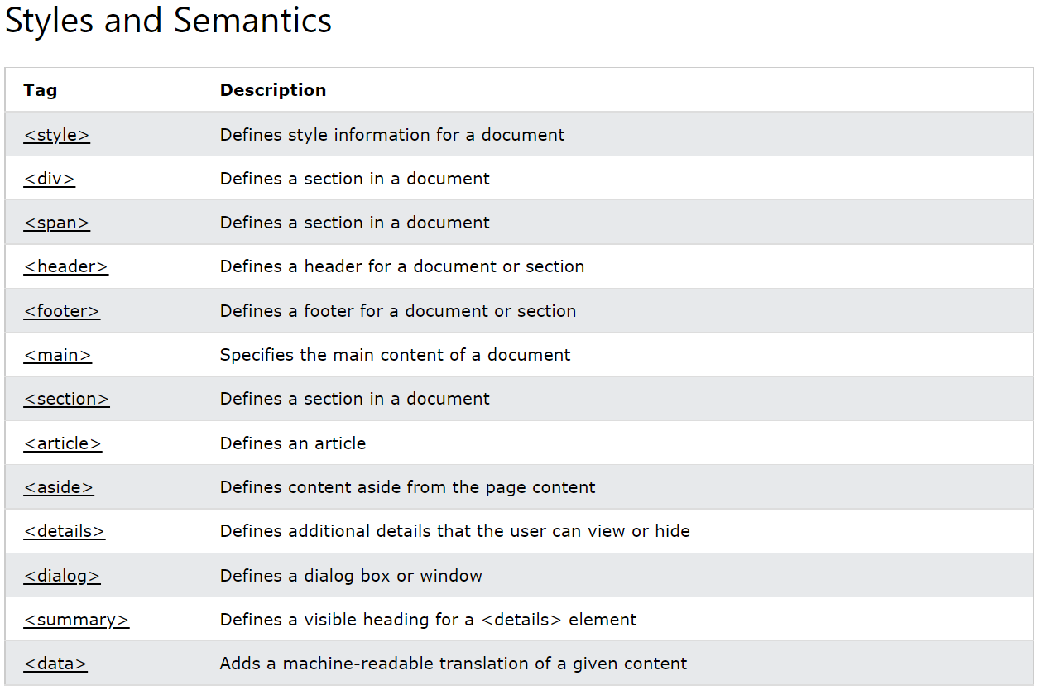

Slide 24
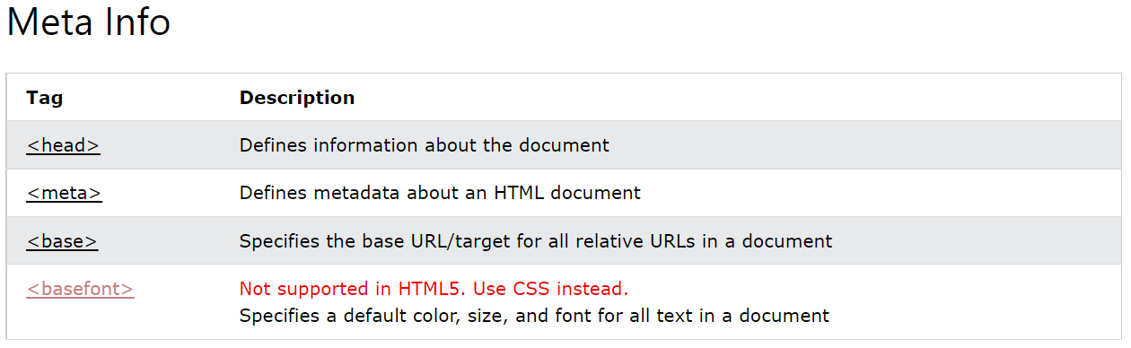

Slide 25
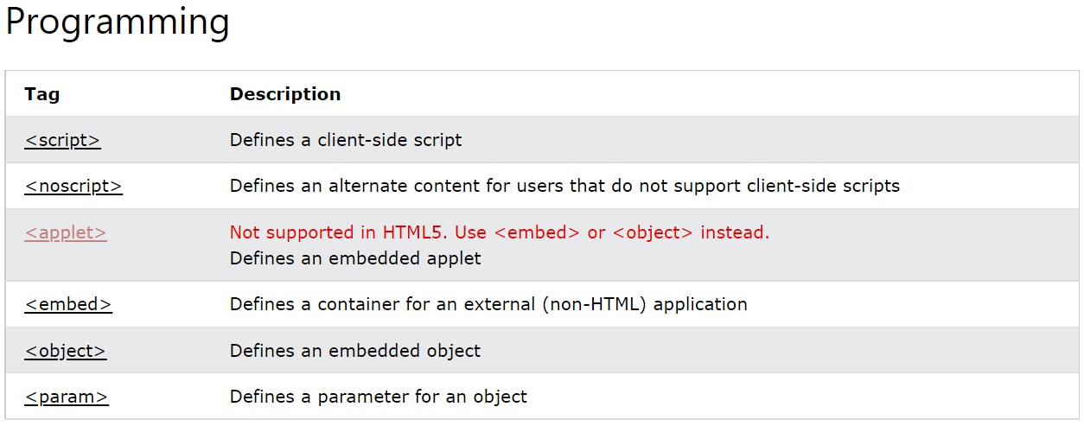

Slide 26
TAGS
<!-->
<!DOCTYPE>
<a>
<abbr>
<acronym>
<address>
<applet>
<area>
<article>
<aside>
<audio>
<b>
<base>
<basefont>
<bdi>
<bdo>
<big>
<blockquote>
<body>
<br>
<button>
<canvas>
<caption>
<center>
<cite>
<code>
<col>
<colgroup>
<data>
<datalist>
<dd>
<del>
<details>
<dfn>
<dialog>
<dir>
<div>
<dl>
<dt>

Slide 27
TAGS
<em>
<embed>
<fieldset>
<figcaption>
<figure>
<font>
<footer>
<form>
<frame>
<frameset>
<h1> - <h6>
<head>
<header>
<hr>
<html>
<i>
<iframe>
<img>
<input>
<ins>

Slide 28
TAGS
<kbd>
<label>
<legend>
<li>
<link>
<main>
<map>
<mark>
<meta>
<meter>
<nav>
<noframes>
<noscript>

Slide 29
TAGS
<object>
<ol>
<optgroup>
<option>
<output>
<p>
<param>
<picture>
<pre>
<progress>
<q>
<rp>
<rt>
<ruby>

Slide 30
TAGS
<s>
<samp>
<script>
<section>
<select>
<small>
<source>
<span>
<strike>
<strong>
<style>
<sub>
<summary>
<sup>
<svg>
<table>
<tbody>
<td>
<template>
<textarea>
<tfoot>
<th>
<thead>
<time>
<title>
<tr>
<track>
<tt>
<u>
<ul>
<var>
<video>
<wbr>

Slide 31
